Slide 1
Splunk

Slide 2

Learning For Today.
Need For Analyzing Machine Data.
Splunk as a Data Analytics Tool.
Use Case: Dominos
Splunk Architecture and Components.

Slide 3
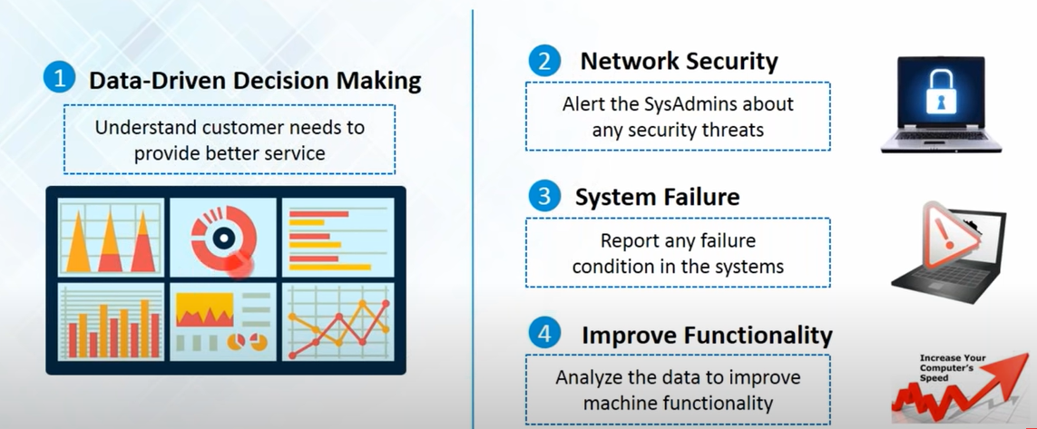

Slide 4
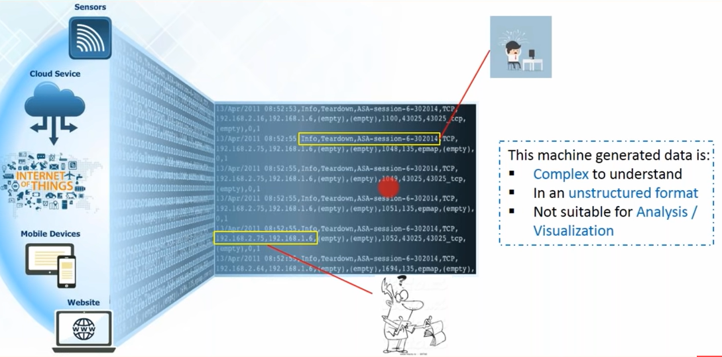

Slide 5
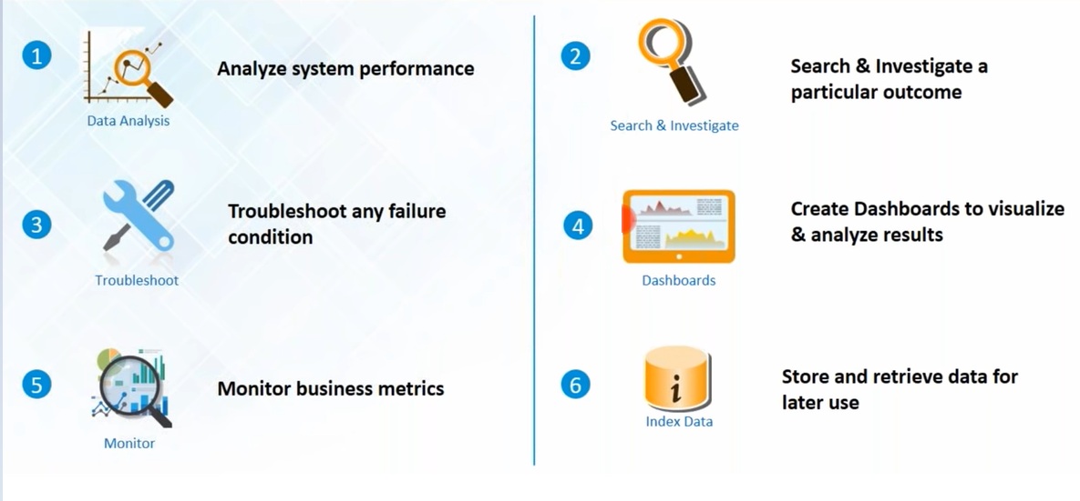

Slide 6
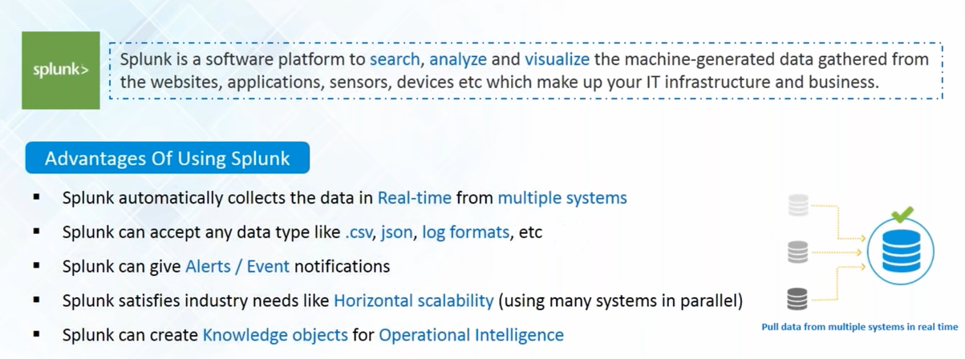

Slide 7
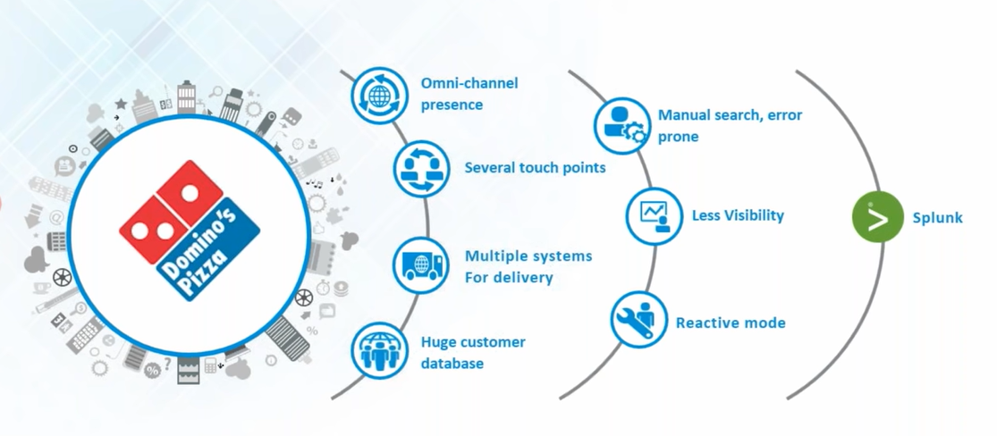
Use Case: Domino’s Pizza

Slide 8
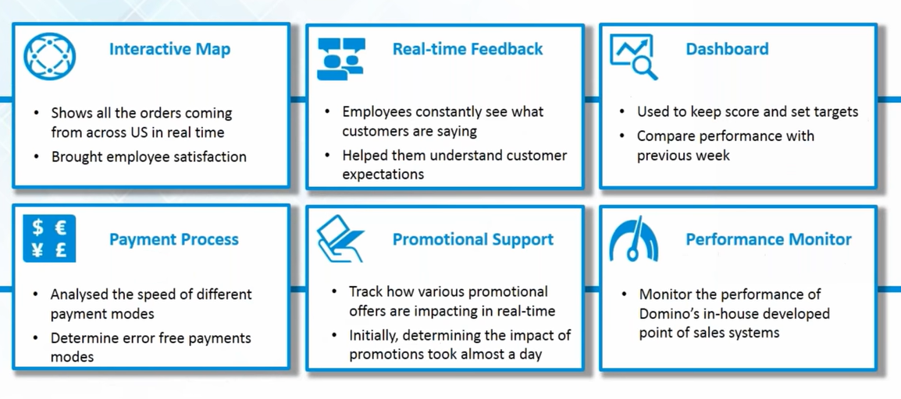

Slide 9
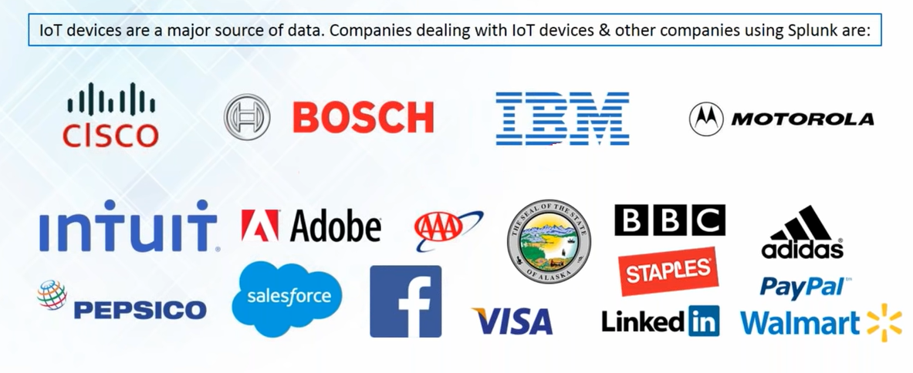
Companies Using Splunk

Slide 10
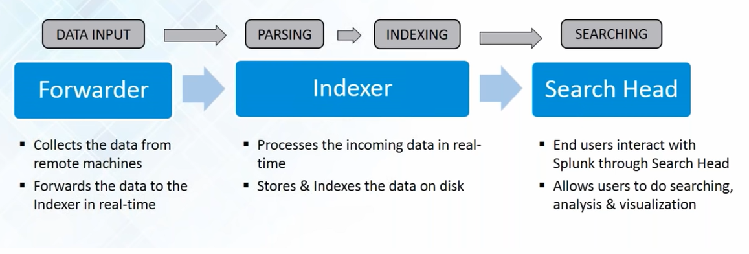
Splunk Components

Slide 11
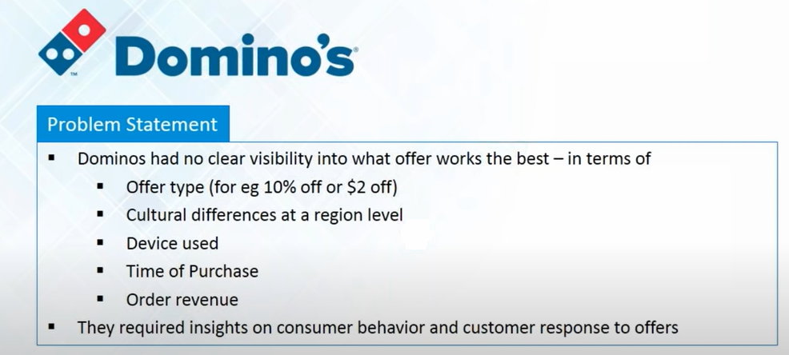

Slide 12
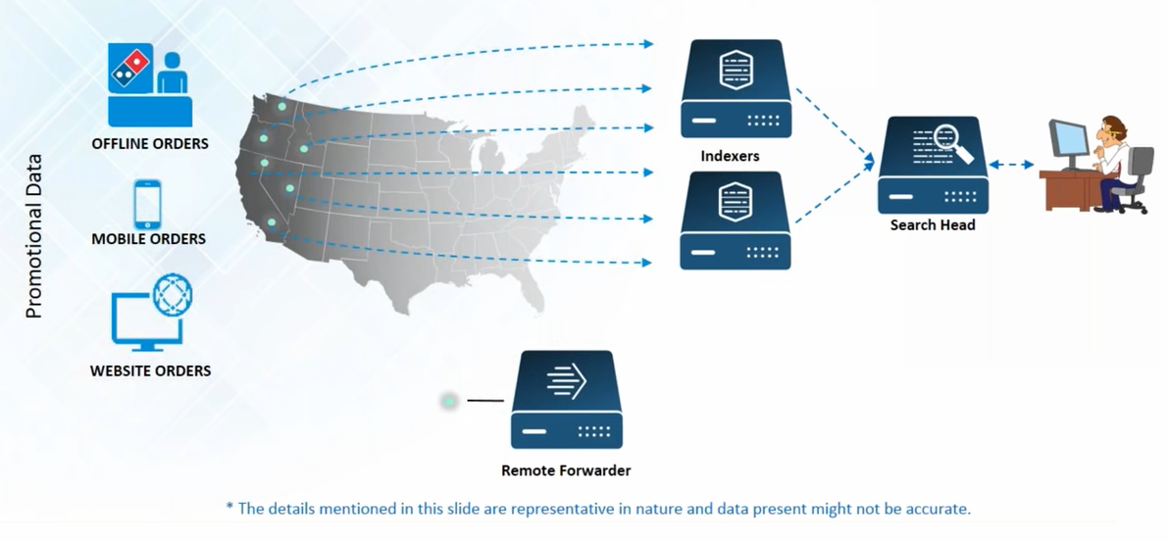
Data Source for Dominos

Slide 13
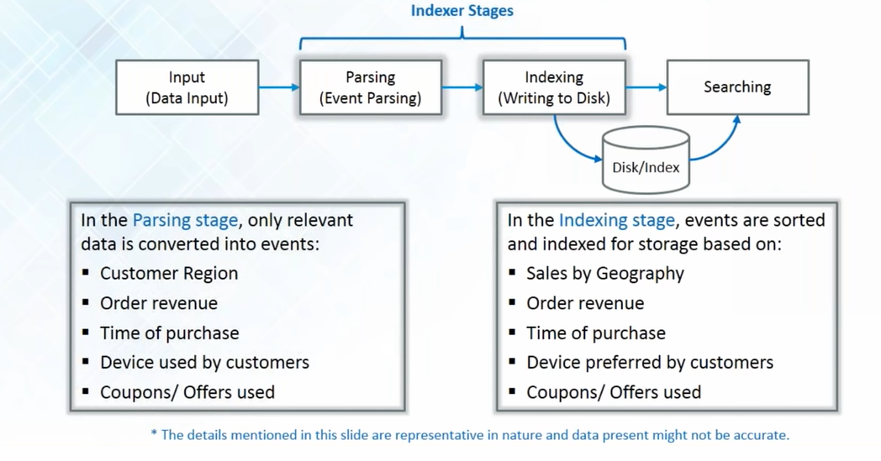

Slide 14
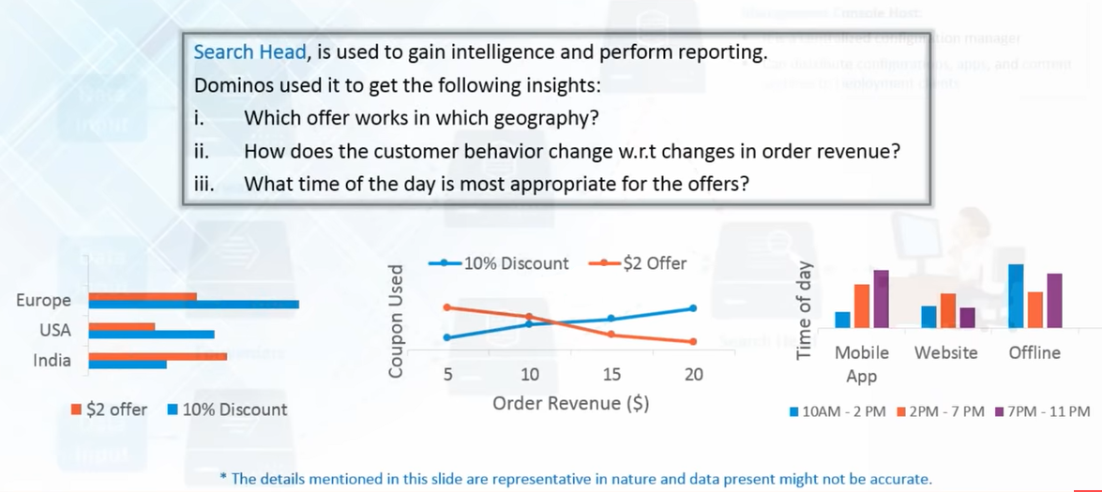
Search Head For Analysis and Visualization

Slide 15
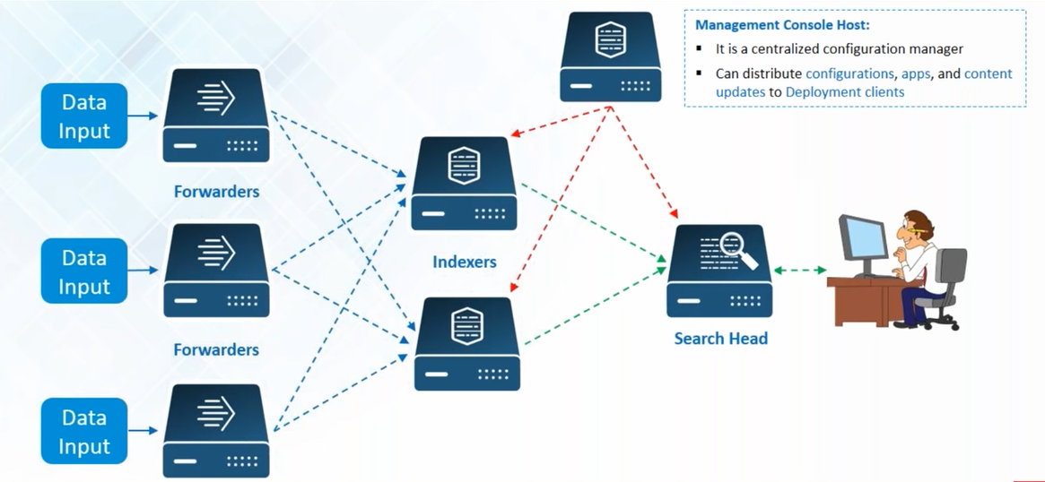
Splunk End-to-End Working Pipeline

